Slide 1
Introduction to Computer Graphics
(CS560/CS460)
Computer graphics means the art and science of creating images of three dimensional objects.
Huge and Fast-moving field that integrates the best of art and science

Slide 2
Introduction to Computer Graphics
Why Computer Graphics:
- Commercial and industrial design
e.g., car model CAD (computer-aided design)
- Scientific presentation
e.g., researchers want to see the results of their theories and experiments
presented as pictures
- Scientific visualization
e.g., statistics data, medical volume data, bio-chemistry data, etc.
- Commercial art and fine art
e.g., Animation, Television Commercials to feature films, Entertainment
- Graphical User Interface
e.g., Programming with quick and flexible manner; training and education; flight/driving training, virtual reality display; game
- Image processing and enhancement
e.g., computer-aided surgery

Slide 3
Introduction to Computer Graphics
Topics in this course:
- Basic conception and architecture
- Raster Algorithm
- Principle of 2D and 3D view
- Principle of 2D and 3D transformation
- Rendering (shading, illumination, texturing, …)
- Modeling (curve and surface representation, …)
- Animation
- Virtual Reality
Course work:
- Programming intensive!
- Math intensive!

Slide 4
Basic Concepts
Computer Vision
- simulate the human visual system, not only “see” the world, but also “understand” the world (image→ object)
Image Processing
- pre-process the image for better “see” or “understand”
Pattern Recognition
- classify and recognize both image content and some other statistic data.
Computer Graphics
- create or synthesize a virtual image object→image)

Slide 5
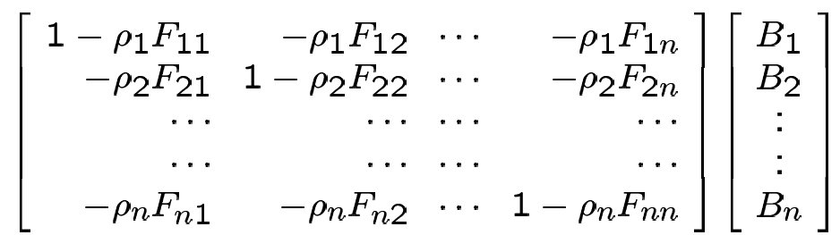
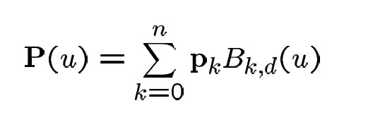
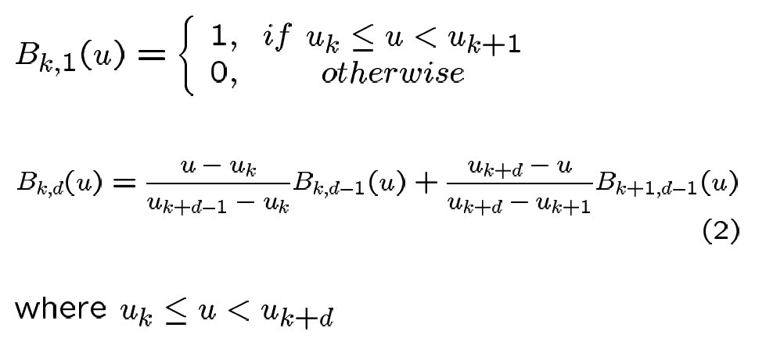
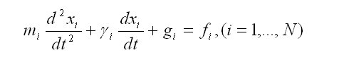
Basic Math
Algebra
Computational Geometry
E.g.,
R = [ ] * [ ]
Interpolation and Approximation
Bezier curves, spline curves, …
Physics based modeling

Slide 6
Computer Model
MODEL: The way to describe and represent the object in the real world.
Scale model
- A scaled up (or down) copy of some object, usually built up from many smaller pieces, or surfaces to describe its shape.
Mathematical model
- A description of physical laws that describes the behavior of something.
Wire model (Line drawing) and Shaded model (shaded drawing)
Static model and Dynamic model
MODELING: The way to create the model
Prepared modeling and Interactive modeling
Subtractive modeling and Additive modeling
(Solid modeling
or Constructive modeling)

Slide 7
Rendering
RENDERING: Creating the image as realistic as possible, representing the image in a high quality for visualization
2D Line drawing
- line, circle, ellipse, text character, and other primitives
2D Image
- area filled
3D wire-frame
- 3D line, polygon
3D image
- surface, shading, texture, transparency.
Data
- Volume rendering

Slide 8

Rendering
(Image Courtesy of University of Utah)

Slide 9

Modeling
Modeling: Object representation
Geometric representation
- line, vertex, polygon,
- curve, surface
Mathematical representation
- using mathematical equation to describe the object and
scene
Special effects/shape presentation
- surface details and texture/lighting, or dynamic modeling

Slide 10

Animation
Animation: Motion or Movement
Animation generation
- Hand-painted process: very time-consuming
- Key-Framing: Interpolation
- Dynamics system: make your motion as physically correct as
realistic as possible
- Procedure motion: programmed motion (simple, but not realistic)
(e.g., if… then…)

Slide 11
Animation
Animation: Motion or Movement
Human Visual System: Persistence of Vision
- When you are shown a picture, it tends to be retained in your mind’s
eye for a very brief period of time
- If the pictures are shown quickly enough, one after the other, then
the new picture arrives before the old one fades, and you perceive a
smooth movement.
- Persistence of vision is what allows conventional file, video, and
animation to provide a successful illusion of movement.
Projection rate
- film: 24 frames/second
- video (television): 30 frame/second

Slide 12
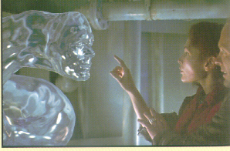
Animation
(image from book Computer graphics principles and practice by Foley, Van Dam, Feiner and Hughes))

Slide 13
Animation
WARPING: Image transformation
Geometric transformation
- linear, non-linear
Object deformation
- automatic, interactive
Special effects presentation
- arts, entertainment.
MORPHING: Image transition

Slide 14
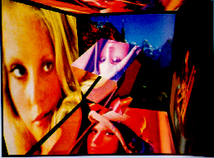
Warping and Morphing
(Image Courtesy of Heckbert and Hanrahan NYIT))

Slide 15
Virtual Reality
VIRTUAL REALITY: Stereo display
Dynamic display (left-eye and right-eye display alternatively)
- simulate the real world, give you the real feeling
Head-Mounted display

Slide 16
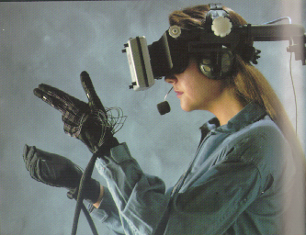
Virtual Reality
(image from book Computer graphics principles and practice by Foley, Van Dam, Feiner and Hughes))

Slide 17
Recent Development
Characteristics:
Fast and Realistic and interactive
Architecture: Parallel algorithm
Display: Advanced raster algorithm with antialiasing, surface simplification, large amount of data rendering (volume rendering)
3D Modeling: Image based and physics based
3D Animation: Key frames, dynamics, procedure motion capture.
Warping and Morphing: Special effects.
Virtual Reality: CAVE 3D stereo display

Slide 18
Computer Graphics Programming
MS Windows: Visual C++, or Visual Studio .Net
Unix, Linux, Irix: C and C++
OpenGL and Mesa
GLUT

Slide 19
Computer Graphics Workstation
Hardware (Physical System)
INPUT
- Keyboard, Image digitizer
OUTPUT
Softcopy (display) Hardcopy(printing)
- Text CRT (Cathode-Ray Tube)
- Printer, Color raster Monitor, Film/Video recorder
- Calligraphic CRT (vector monitor), Plotter
- Head-Mounted display (HMD) (stereo)
TRACKER
- Data Tablet (absolute positioning)
- Stylus/Pen (absolute positioning)
- Puck (absolute positioning)
- Mouse (relative positioning)
- Joystick
- Trackball
- Space Tracker (3D position and orientation)
- Hand Tracker

Slide 20
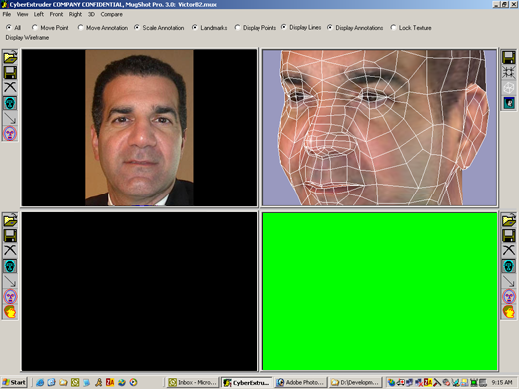
Example (Demo)

Slide 21
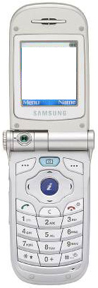

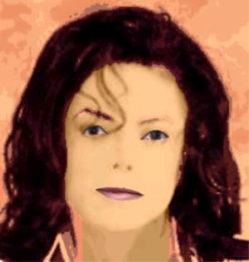
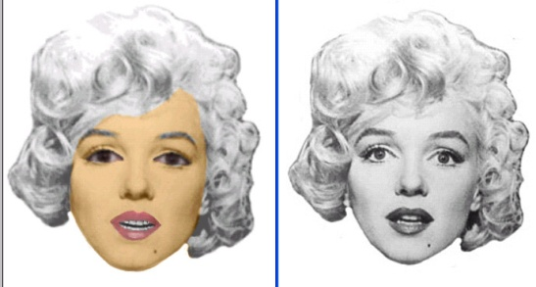
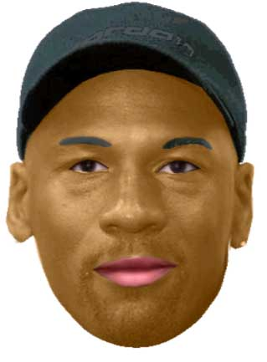
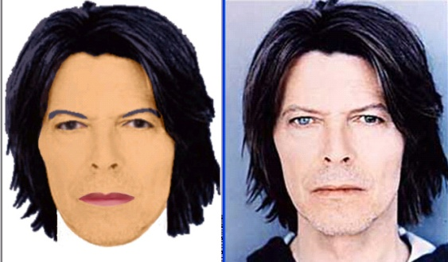
Multi-Media Messaging with Individualized Talking Avatars

Slide 22
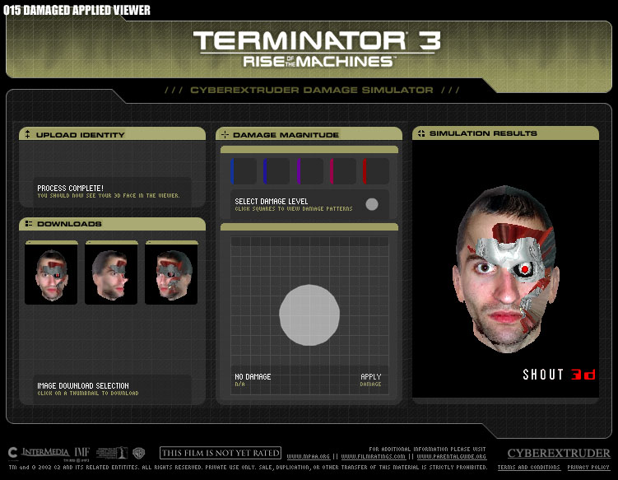
Appliations

Slide 23
References
Text books:
(1) D. Hearn and M.P. Baker, Computer Graphics with OpenGL. Third Edition, Prentice Hall 2004 (ISBN: 0-13-015390-7).
References: (1) Computer graphics: Principle and Practice
(2) 3D computer graphics: A user’s guide for artists and designers
(3) OpenGL reference menu
(4) Principles of three-dimensional computer animation
Journals:
IEEE Transactions on Visualization
IEEE Computer Graphics and Applications
Graphical Model and Image Processing
Computer & Graphics
The Visual Computer
Conferences:
SIGGRAPH (ACM Transaction on Computer Graphics)
Proceedings of Computer Graphics International
EURO Graphics
Internet:
http://www.sgi.com
http://www.opengl.org/
http://techpubs.sgi.com/library/
http://reality.sgi.com/opengl/spec3/spec3.html
http://codeguru.earthweb.com/opengl/GLDIB.shtml
http://devcentral.iftech.com/learning/tutorials/mfc-win32/opengl/2.asp
http://ask.ii.uib.no/ebt-bin/nph-dweb/dynaweb/SGI_Developer/OpenGL_PG/

